Slide 1
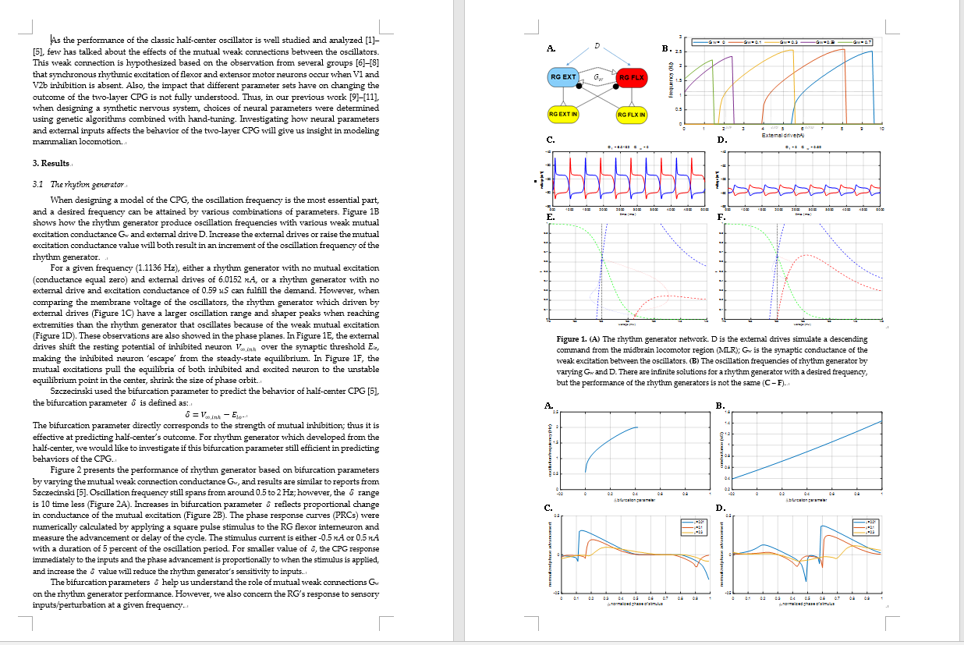
Drafting the manuscript:

Slide 2
Analyzing performance of the two-layer CPGs and design tools for neural controllers
Goal:
Investigate how neural parameters and external inputs impact the performance of the two-layer CPG, establishing a design process and tools for future locomotion studies and robot controllers.
Outline:
Introduction
Method
Analyzing the rhythm generator performance
Analyzing the effect of individual parameters in the two-layer CPG
Analyzing performance of the two-layer CPG in different combination of parameters
Conclusion

Slide 3
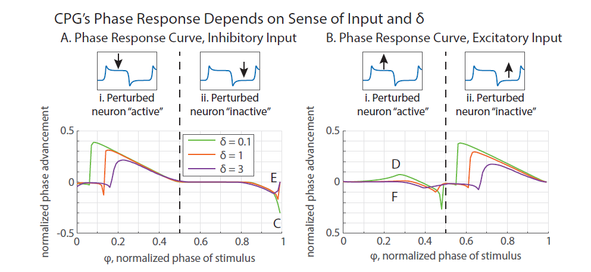
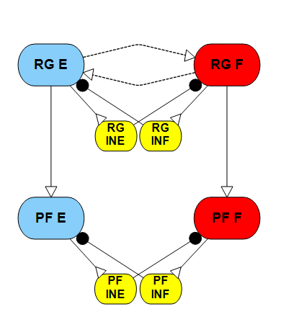








Analyzing the effect of individual parameters in the two-layer CPG
$$D$$
$$G_{w}$$
G
$$G_{c}$$
$$G_{c}$$
$$I_{app}=±1 nA$$
$$I_{app}=±1 nA$$
$$G_{syn}=$$
$$\text{1.6198}$$
D = 0 $G_{w}$ = 0 G = 1.6198
$$G_{c}=0.1$$
When the connection between the two layer is strong (≥0.1), the pattern formation layer’s phase response curve is totally determined by the phase response of the rhythm generator layer.

Slide 4

Analyzing the effect of individual parameters in the two-layer CPG
$$D$$
$$G_{w}$$
G
$$G_{c}$$
$$G_{c}$$
$$I_{app}=±1 nA$$
$$G_{syn}=$$
$$\text{1.6198}$$
D = 0 $G_{w}$ = 0 G = 1.6198
$$G_{c}=0.01$$
When the connection between the two layer is weak (<0.1), the pattern formation layer’s phase response curve still correlated with the rhythm generator’s response, but the phase advancement is much smoother.

Slide 5
Analyzing the effect of individual parameters in the two-layer CPG
$$D$$
$$G_{w}$$
G
$$G_{c}$$
$$G_{c}$$
$$I_{app}=±1 nA$$
$$G_{syn}=$$
$$\text{1.6198}$$
$$I_{app}=±1 nA$$
D = 0 $G_{w}$ = 0 G = 1.6198
$$G_{c}=0.1$$
When the connection between the two layer is strong (≥0.1), the pattern formation layer’s phase response curve is totally determined by the phase response of the rhythm generator layer.
Notes:
Iapp/Gc normalized ratio

Slide 6
Analyzing the effect of individual parameters in the two-layer CPG
$$D$$
$$G_{w}$$
G
$$G_{c}$$
$$G_{c}$$
$$I_{app}=±1 nA$$
$$G_{syn}=$$
$$\text{1.6198}$$
$$I_{app}=±1 nA$$
D = 0 $G_{w}$ = 0 G = 1.6198
$$G_{c}=0.01$$
When the connection between the two layer is weak (<0.1), the rhythm generator will smooth the phase response curve of pattern formation layer, make it less sensitive to stimulus.

Slide 7

RG phase response
PF phase response
Perturb RG
Ratio = 100
$${I_{app}}/{G_{c}}$$
Ratio = 50
Ratio = 20
Ratio = 10
Ratio = 5

Slide 8
RG phase response
PF phase response
Perturb PF
Ratio = 100
$${I_{app}}/{G_{c}}$$
Ratio = 50
Ratio = 20
Ratio = 10
Ratio = 5

Slide 9
- 0.5 nA
- 0.5 nA
- 0.5 nA
- 0.5 nA
Gc = 0.1
RG phase response
Gc = 0.05
PF phase response
Gc = 0.01
Gc = 0.005

